Slide 1

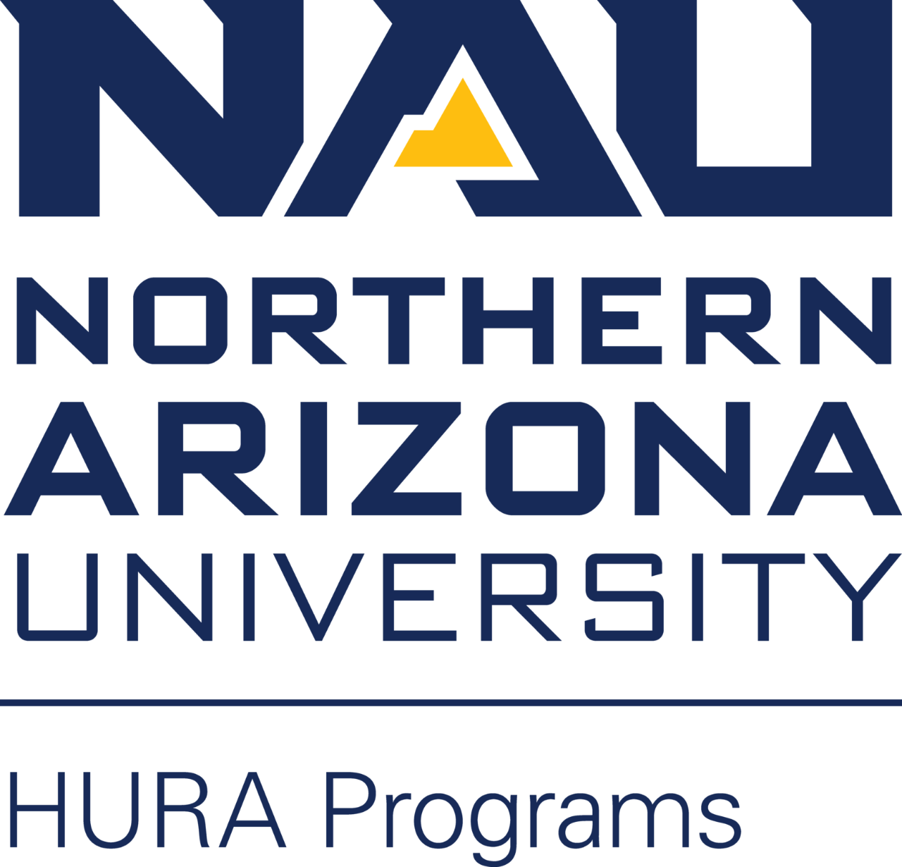

Redefine NAU Astronomy Courses with Innovative Teaching Styles
Northern Arizona University
Department of Astronomy and Planetary Science
Principle Investigator: Savannah Perez
Mentor: Lisa L.-H. Chien, Ph. D.

Slide 2
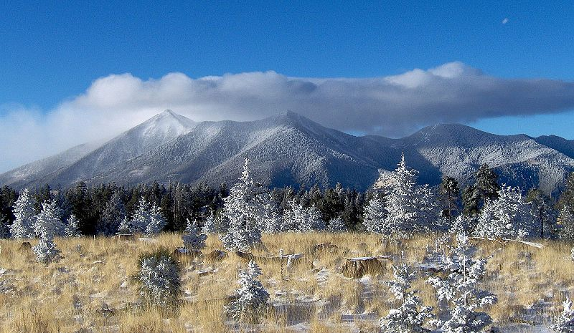
What are Effective Teaching Styles?
Student-Centered classroom for content “discovery”
  “Flipped” classroom
  Student interaction: activities in class, lab content
Goal: Use one of these teaching styles to create content for AST201: Indigenous Astronomy course
  Start by outlining Units and Lesson objectives
  Create activities/classwork/projects
  Create online instructional pieces
    Video Lesson
    Reading Material
Image: “ San Francisco Peaks - Navajo Sacred Mountain”
Credit: Navajo People, www.navajopeople.org

Slide 3
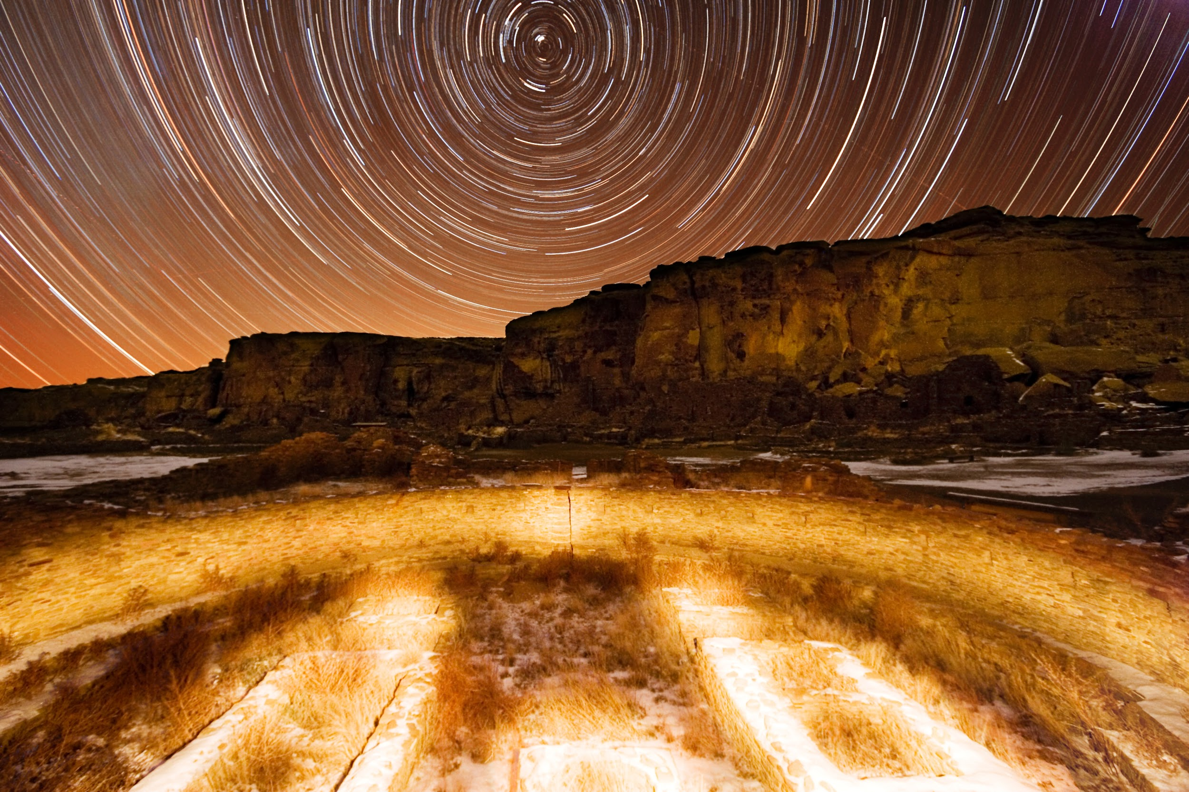
Why Indigenous Astronomy Lab Content?
Important for Arizona and Flagstaff community
  Applying indigenous astronomy as a group
  Discuss local tribe history
  Broaden student cultural awareness
Take a 200+ student class and create 20+ student lab time
  Easier for collaboration and resources
Created under NASA Space Grant
  Online class content
NAU approved lab content
  Will be implemented Fall 2021
Image: Chaco Canyon, “Pueblo Bonito at night”
Credit: National Park Service. www.nps.gov

Slide 4
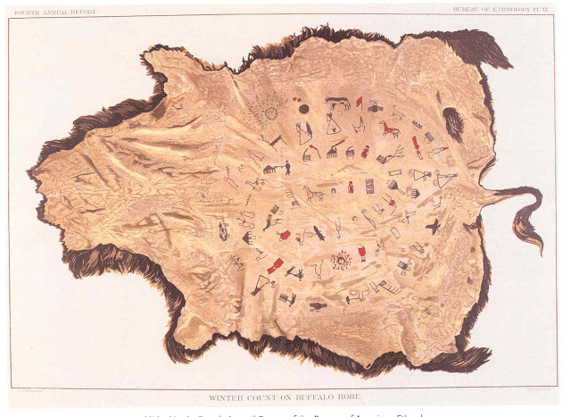

How Do You Teach Indigenous Astronomy?
Class Content
  Cultural Understanding
  Father Sky
  Mother Earth
Discussion Points
  Native History
  Lessons about different tribes (Southwest, Mesoamericans, Hawaiians, etc.)
  Parallels between Western vs Traditional Indigenous Astronomy
    Indigenous/Western constellations
    Star lores vs stellar astronomy
    Cosmology/Cosmogony
    Planetary motions in the two views
Image: “The Year the Stars Fell: Lakota Winter Counts at the Smithsonian”
Credit: Smithsonian Institution, www. si.edu

Slide 5

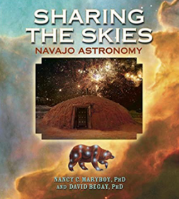
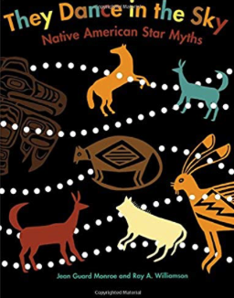
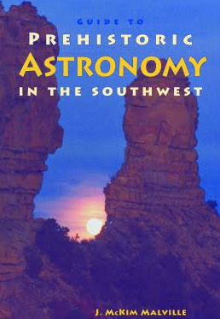
How You Can Create Lab Content
Break down the main concepts and objectives of each unit
Develop an activity where students “discover” the concepts
Plan out how one can give instruction for this lab
Create additional material for to account for additional time
Additional Resources Used:
Society for Cultural Astronomy in the American Southwest
  http://www.scaas.org
National Museum of the American Indian
  https://americanindian.si.edu

Slide 6
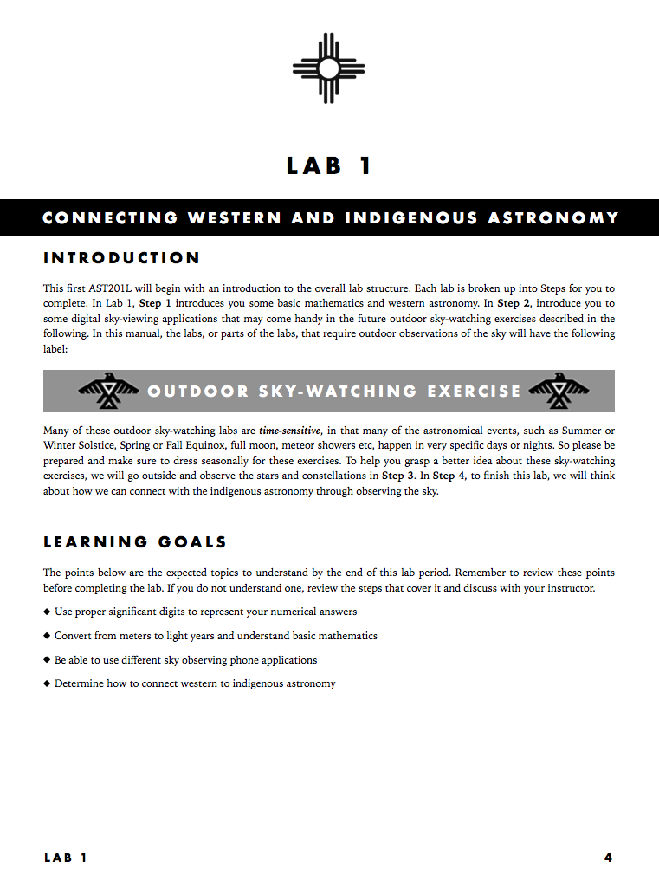
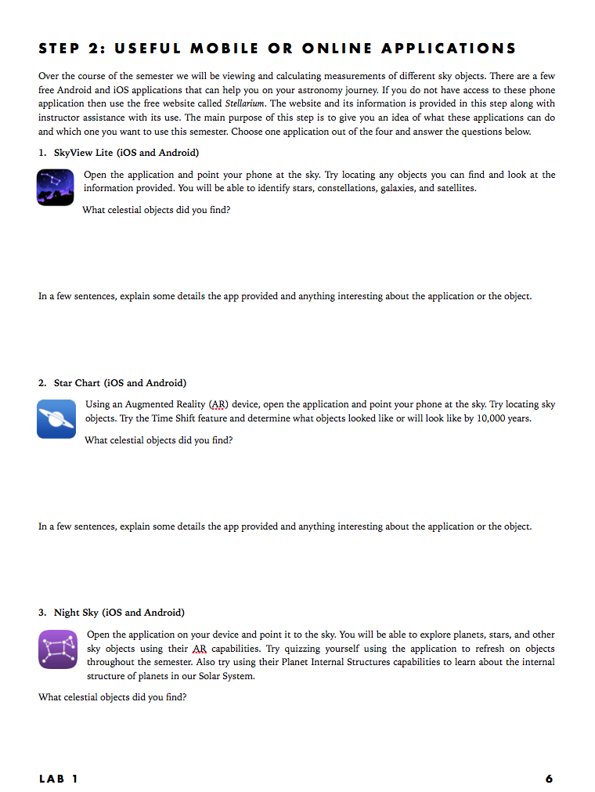
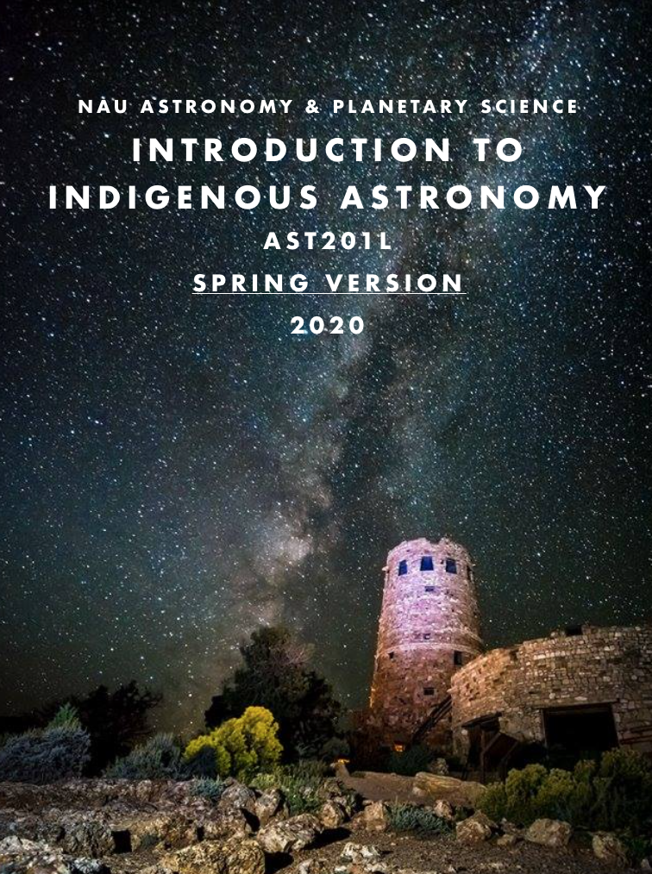
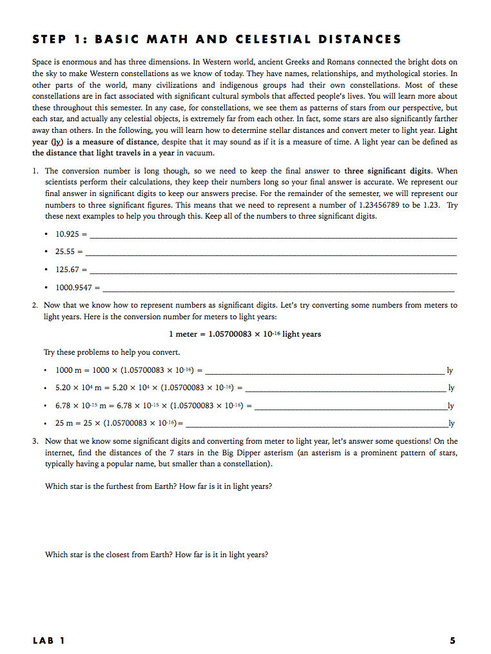
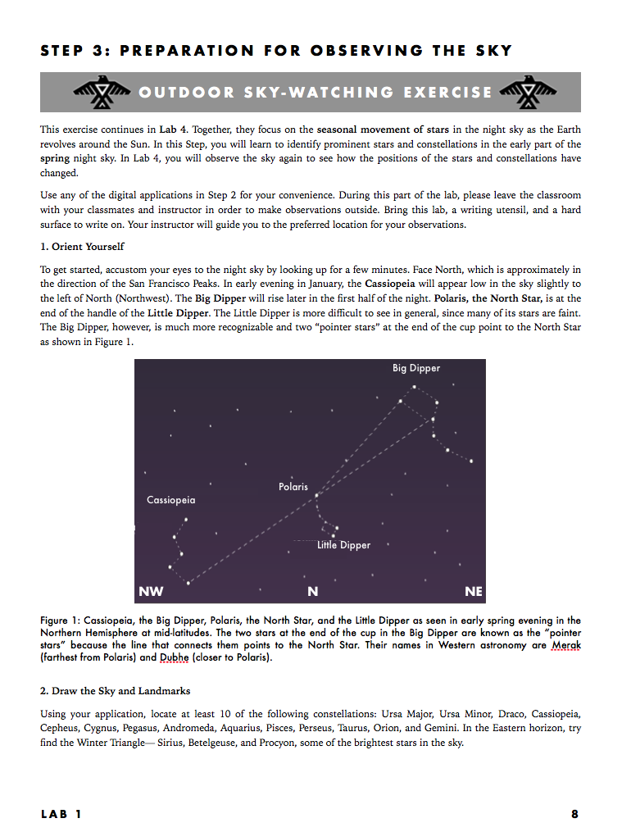
Notes:
Key points
Fall and Spring version
Learning Goals met
Sky Watching Portion
Split into steps

Slide 7
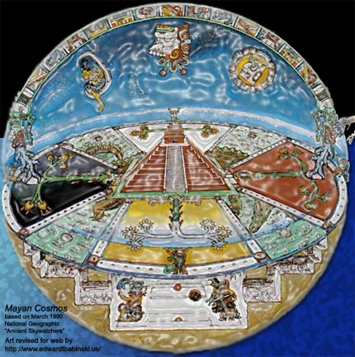
Plans For the Future
Acknowledgements
Finish Student Lab Manual
  Includes labs for both Spring and Fall semesters
Create Instructor Lab Guide
  Includes: Keys, Content Description, Additional Activities, Additional Resources
Outline Instructor Unit/Lesson Guide
Thank you to NASA Space Grant for supporting this project.
Thank you to the Hooper Undergraduate Research Award (HURA) for funding this project.
What Questions Can I Answer?

